Slide 1

Generation of iris strips patterns using Gang
Jose Corona
11/3/2020
Computer Vision

Slide 2
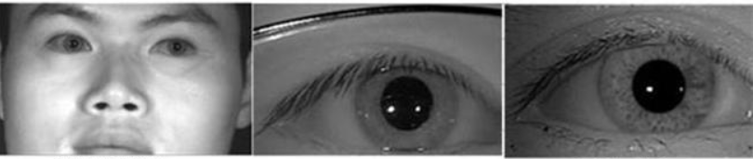
Introduction
Biometric authentication now a days is more common on devices like smartphones, is based on physiological characteristics of the person such as fingerprints, face and iris patterns.

Slide 3
Problem statement
Focus using GAN based methods to generate iris strips to allow better training of AI models.
Problems to get clear iris image in different environments, it needs to scale up the images.

Slide 4

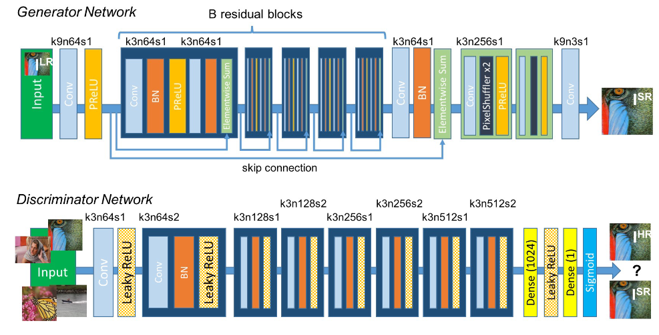
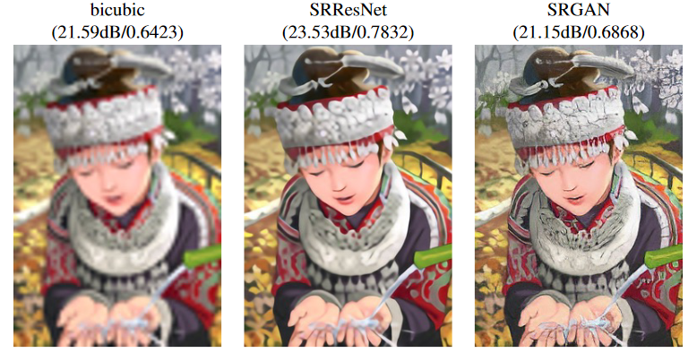
Methodology
Implement StyleGAN2 framework from NVIDIA and train it just with iris patterns.
Implement Super Resolution GAN

Slide 5
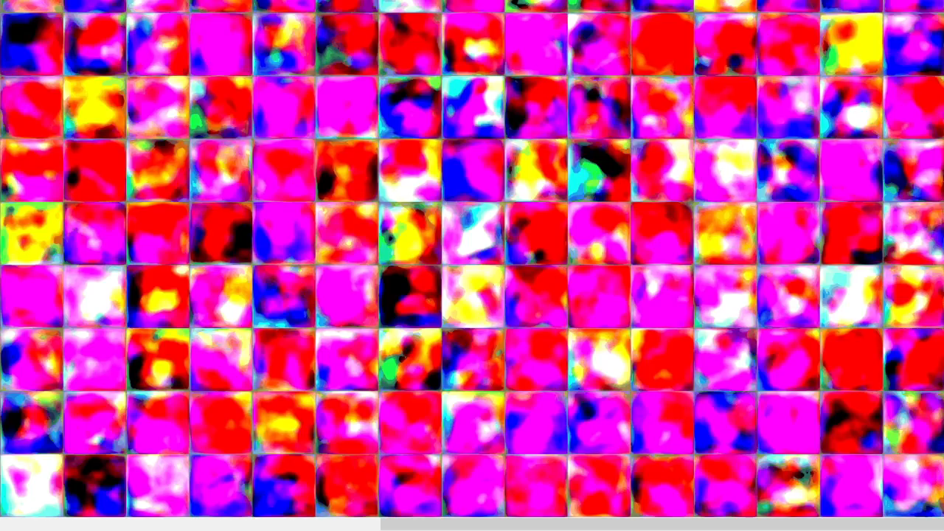
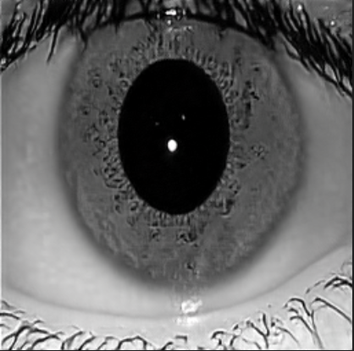
Results StyleGAN
To check that the GAN model could generate fake iris patterns with quality and diversity it was calculated the FID-Score, and the model get a high FID-Score, 39.
Model after 50 ticks, each training tick take 36 to 30 minutes.

Slide 6
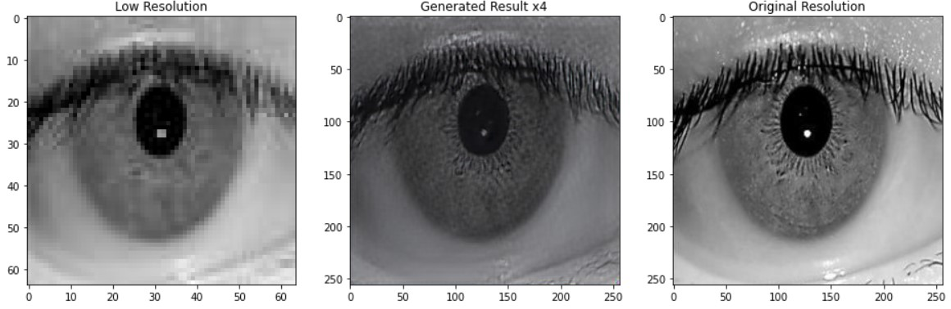
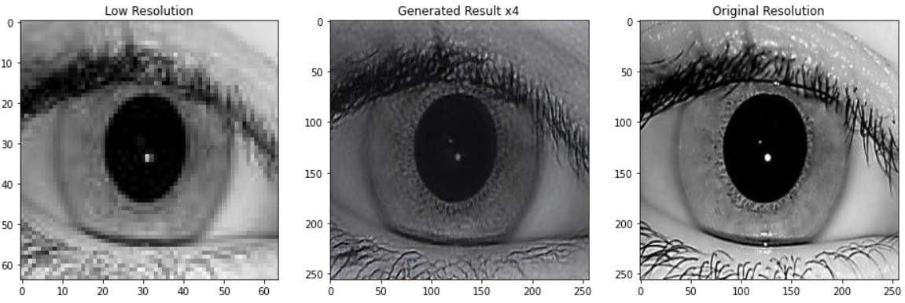
Results Super Resolution GAN

Slide 7
Conclusion
StyleGAN2 framework could be trained with custom dataset.
FID-Score is used to measure numerically the quality and diversity of GAN models. This model could achieve a high FID Score.
Training StyleGAN2 It takes a lot of resources and time to train.
Super Resolution GAN could achieve scaling factors up to 4x having good resolution. To train the generator we need to decrease to a low resolution the images and for the discriminator model is trained with the original high-resolution image and the output of the generator. And is need a pretrained VGG19 model for features extraction while training in the generator.

Slide 8
References
R. Saini “Comparison of various biometric methods,” International Journal of Advances in Science and Technology, vol. 2, no. 1, 2, 2014.
S. Minaee, A. Abdolrashidi, Iris-GAN: Learning to Generate Realistic Iris Images Using Convolutional GAN, CoRR, abs/1812.04822, 2018.
C. Ledig, L. Theis, “Photo-realistic single image super-resolution using a generative adversarial network,” Proceedings of the IEEE Conference on Computer Vision and Pattern Recognition, pp. 4681–4690, 2017.
K. Kashihara, "Iris Recognition for Biometrics Based on CNN with Super-resolution GAN," 2020 IEEE Conference on Evolving and Adaptive Intelligent Systems (EAIS), Bari, Italy, 2020, pp. 1-6.
https://github.com/hindupuravinash/the-gan-zoo
https://github.com/NVlabs/stylegan2.git

